Slide 1
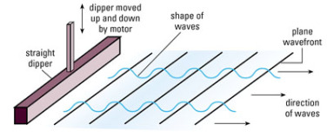
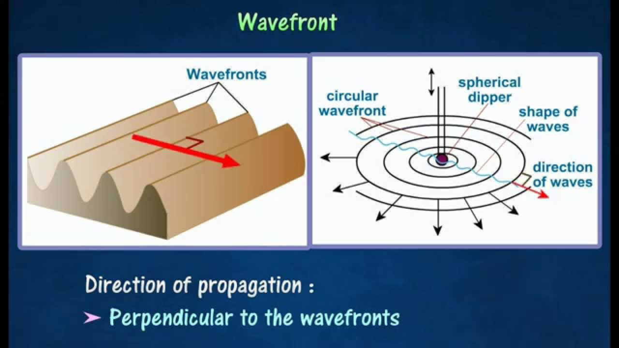
Lecture 22
Wave front: In physics the wave front of a time-varying field is the set of all points where the wave has the same phase.

Slide 2
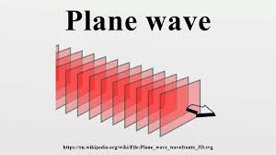
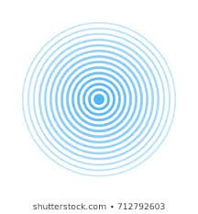
Lecture 22
A plane wave is a constant-frequency wave whose wave fronts are infinite parallel planes of constant peak-to-peak amplitude normal to the phase velocity vector.
Circular wave on the water surface generated by a small ball oscillating in the vertical direction.

Slide 3
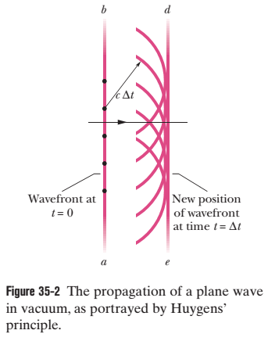
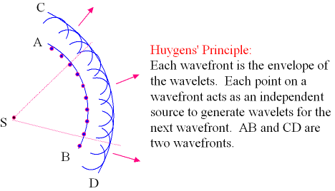
Light as a Wave
Huygens’ wave theory is based on a geometrical construction that allows us to tell where a given wavefront will be at any time in the future if we know its present position. Huygens’ principle is:
All points on a wavefront serve as point sources of spherical secondary wavelets. After a time t, the new position of the wavefront will be that of a surface tangent to these secondary wavelets.

Slide 4
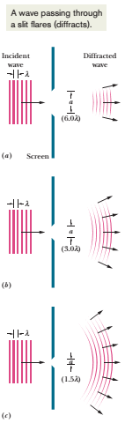
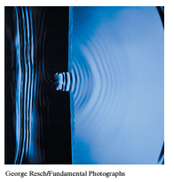
Diffraction
If a wave encounters a barrier that has an opening of dimensions similar to the wavelength, the part of the wave that passes through the opening will flare (spread) out—will diffract—into the region beyond the barrier. The flaring is consistent with the spreading of wavelets in the Huygens construction of Fig. 35-2. Diffraction occurs for waves of all types, not just light waves; Fig. 35-6 shows the diffraction of water waves traveling across the surface of water in a shallow tank.

Slide 5
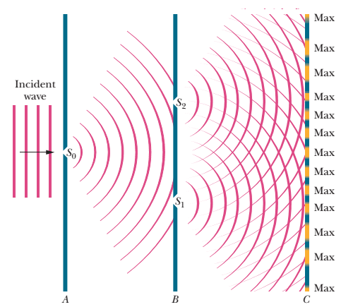
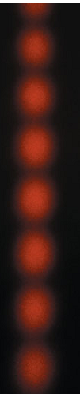
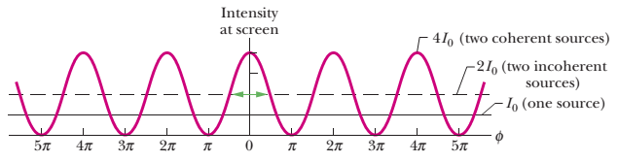
35-2 YOUNG’S INTERFERENCE EXPERIMENT:
To form Interference, the incident light satisfy two conditions:
(1) Monochromatic source: Light consists of one colour or one wavelength.
(2) Coherent source: Plane waves from the monochromatic source maintain a constant phase relation. If two waves are out of phase, this phase difference must not change with time.
diffracted wavs
diffracted wavs
interference

Slide 6
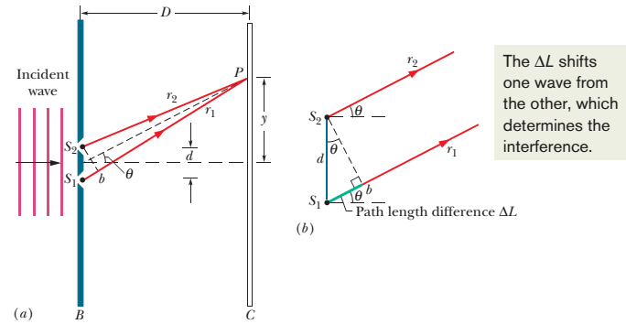
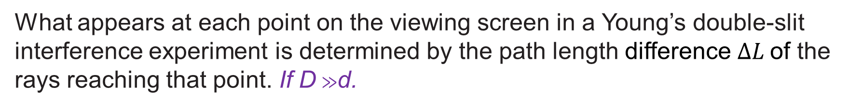
Locating the Fringes:
Path Length Difference: The phase difference between two waves can change if the waves travel paths of different lengths.
What appears at each point on the viewing screen in a Young’s double-slit interference experiment is determined by the path length difference $∆L$of the rays reaching that point. If D $≫$d.

Slide 7
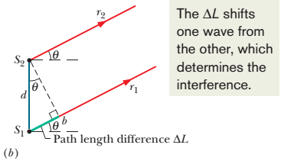
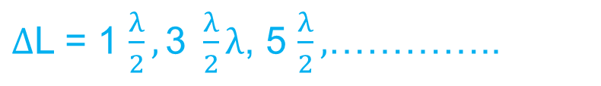



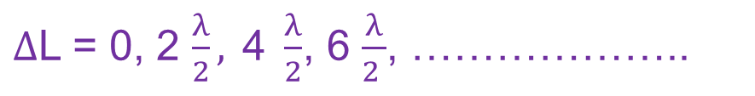
Condition for maximum and minimum:
In phase (Constructive interference): bright fringe (maxima)
sin$θ$ = $\frac{∆L}{d}$
$Path length difference, ∆$L = d sin$θ$
$∆$L = 0, 2 $\frac{λ}{2}, \text{4 }\frac{λ}{2}$, 6 $\frac{λ}{2 }$, ………………..
d sin$θ$= 0, $λ$, 2$λ$, 3$λ$,…………
d sin$θ$ = m$λ$for m = 0, 1, 2, 3 . . . (maxima-bright fringe)
Out of phase (Destructive interference): dark fringe (minima)
$∆$L = 1 $\frac{λ}{2},\text{3} \frac{λ}{2}λ$, 5 $\frac{λ}{2},$…………..
d sin$θ$ = (m + $\frac{1}{2}$) $λ$for m = 0, 1, 2, 3 . . . (minima-dark fringe)

Slide 8
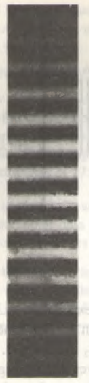
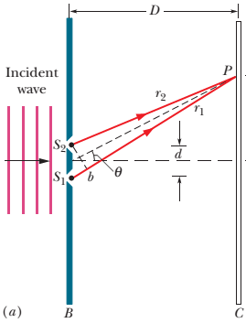

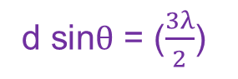
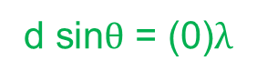
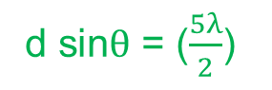
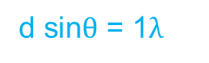
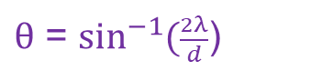
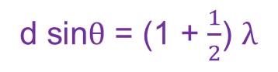
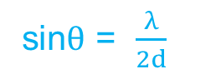
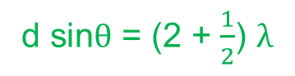
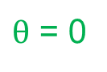
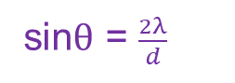
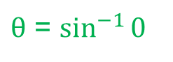
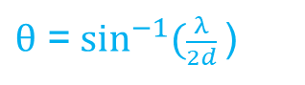
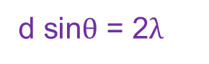
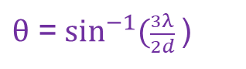
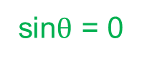
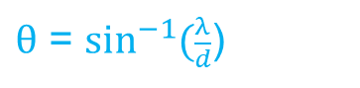
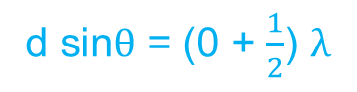
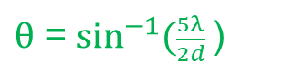
Find the angle to any fringe:
bright fringe: d sin$θ$ = m$λ$for m = 0, 1, 2, 3 . . .
(1) m = 0: central maximum
d sin$θ$ = (0)$λ$
sin$θ$ = 0
$θ$ = $\sin^{−1}{0}$
$θ$ = 0
(2) m = 1: first bright fringe/ first maxima
d sin$θ$ = 1$λ$
sin$θ$ = $\frac{λ}{d}$
$θ$ = $\sin^{−1}{(\frac{λ}{d}}$)
(3) m = 2: second bright fringe/ second maxima
d sin$θ$ = 2$λ$
sin$θ$ = $\frac{2λ}{d}$
$θ$ = $\sin^{−1}{(\frac{2λ}{d}}$)
Central maximum
dark fringe: d sin$θ$ = (m + $\frac{1}{2}$) $λ$for m = 0, 1, 2, 3 . . .
(1) m = 0: first dark fringe/ first minima
d sin$θ$ = (0 + $\frac{1}{2}$) $λ$
sin$θ$ = $\frac{λ}{2d}$
$θ$ =$\sin^{−1}{(\frac{λ}{2d}}\text{)}$
(2) m = 1: second dark fringe/ second minima
d sin$θ$ = (1 + $\frac{1}{2}$) $λ$
d sin$θ$ = ($\frac{3λ}{2}$)
$θ$ =$\sin^{−1}{(\frac{3λ}{2d}}\text{)}$
(3) m = 2: third dark fringe/ third minima
d sin$θ$ = (2 + $\frac{1}{2}$) $λ$
d sin$θ$ = ($\frac{5λ}{2}$)
$θ$ =$\sin^{−1}{(\frac{5λ}{2d}}\text{)}$

Slide 9
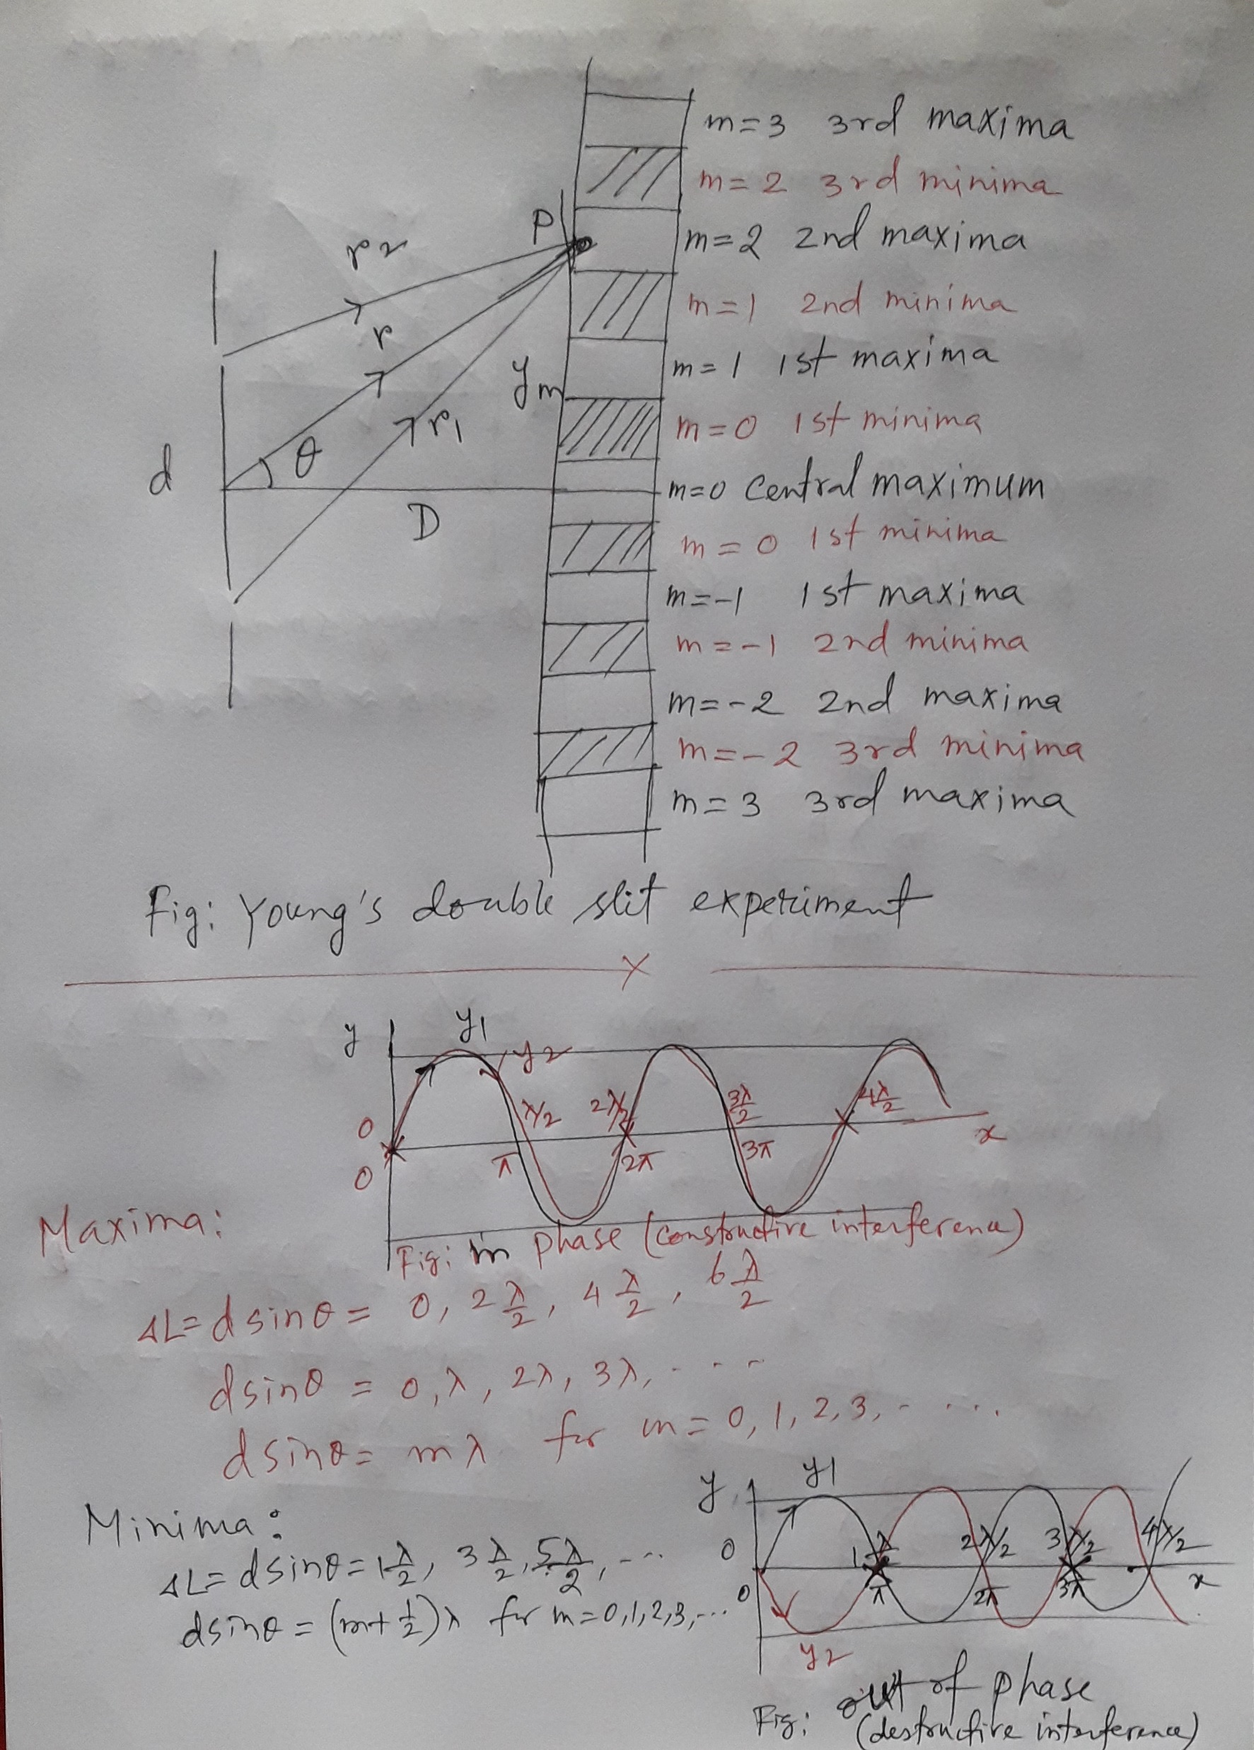

Slide 10
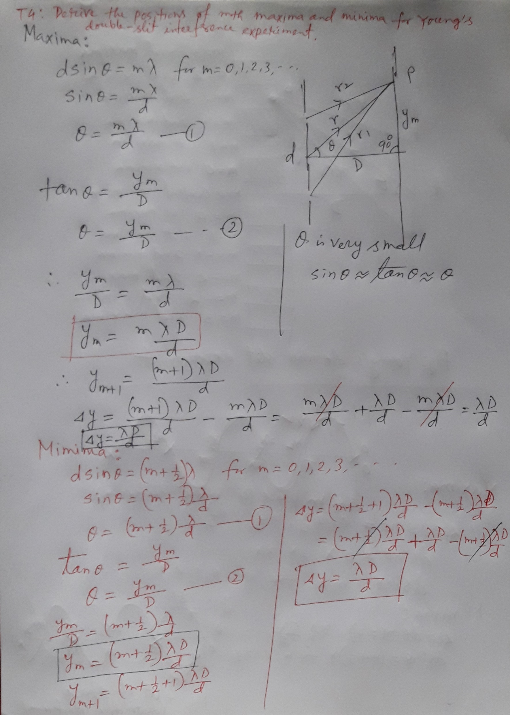

Slide 11
20. Monochromatic green light, of wavelength 550 nm, illuminates two parallel narrow slits 7.70 mm apart. Calculate the angular deviation (θ in Fig. 35-10) of the third-order bright fringe (a) in radians and (b) in degrees.

Slide 12
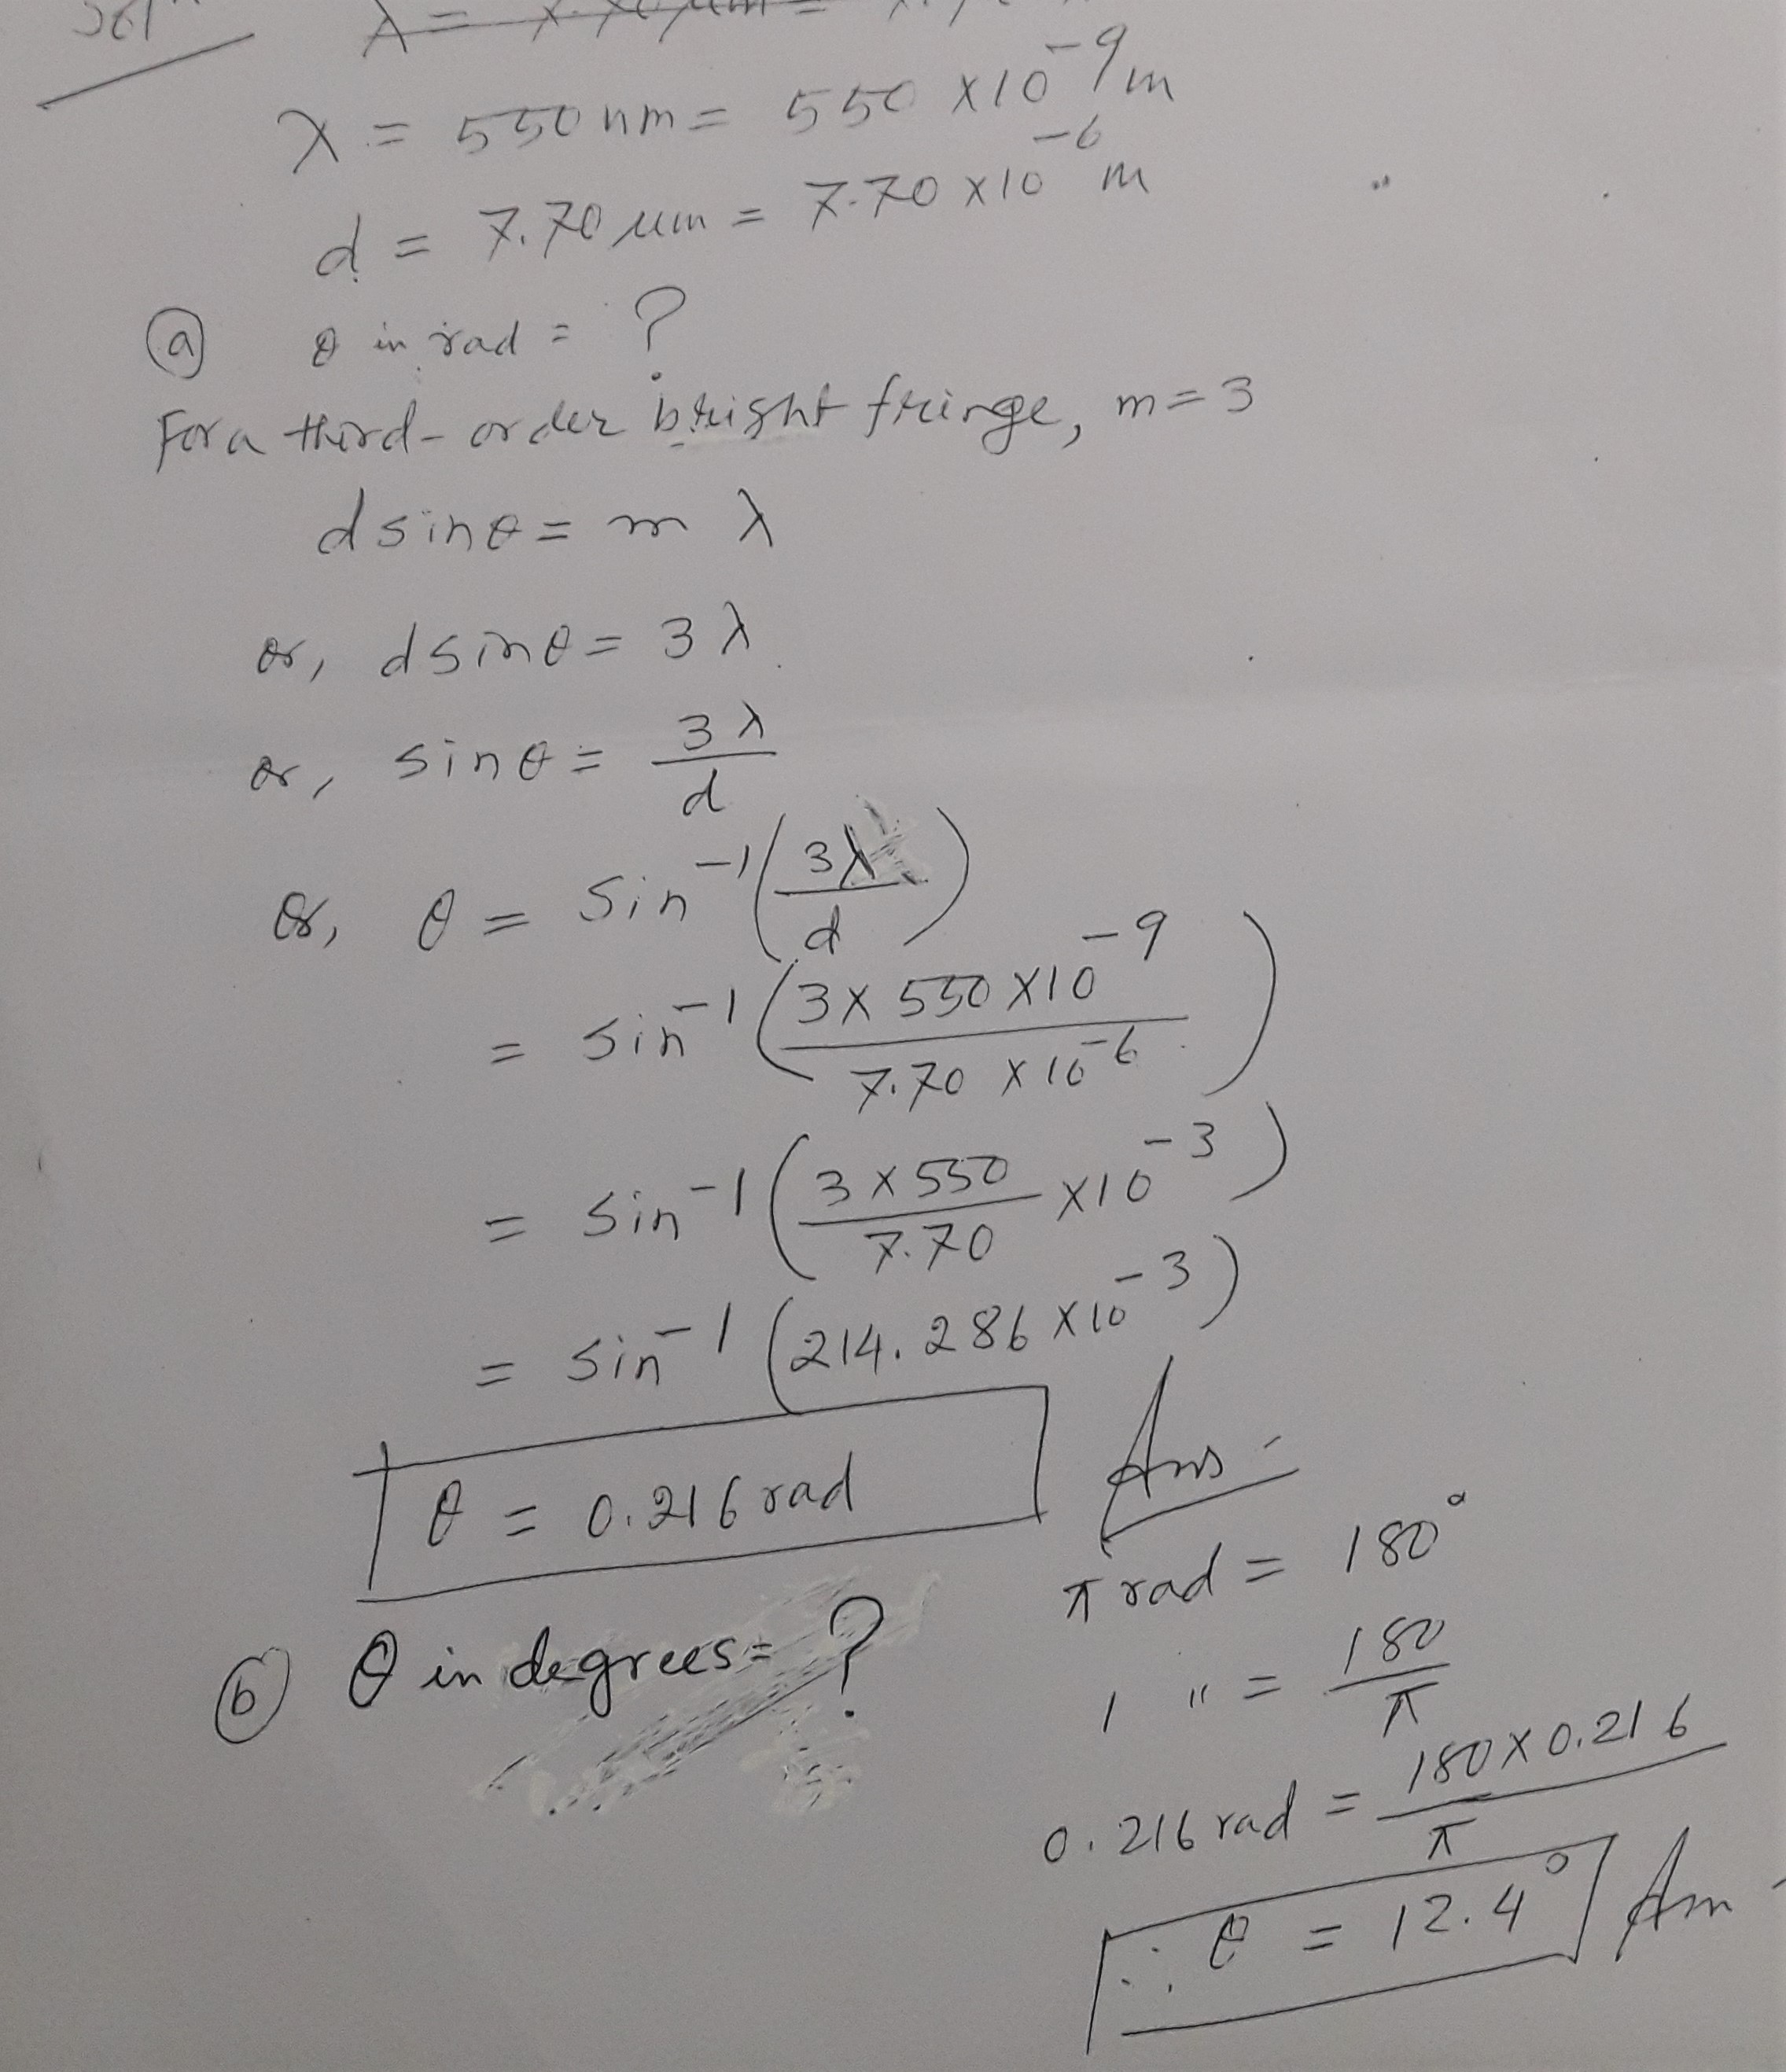

Slide 13
93. If the distance between the first and tenth minima of a double-slit pattern is 18.0 mm and the slits are separated by 0.150 mm with the screen 50.0 cm from the slits, what is the wavelength of the light used?

Slide 14
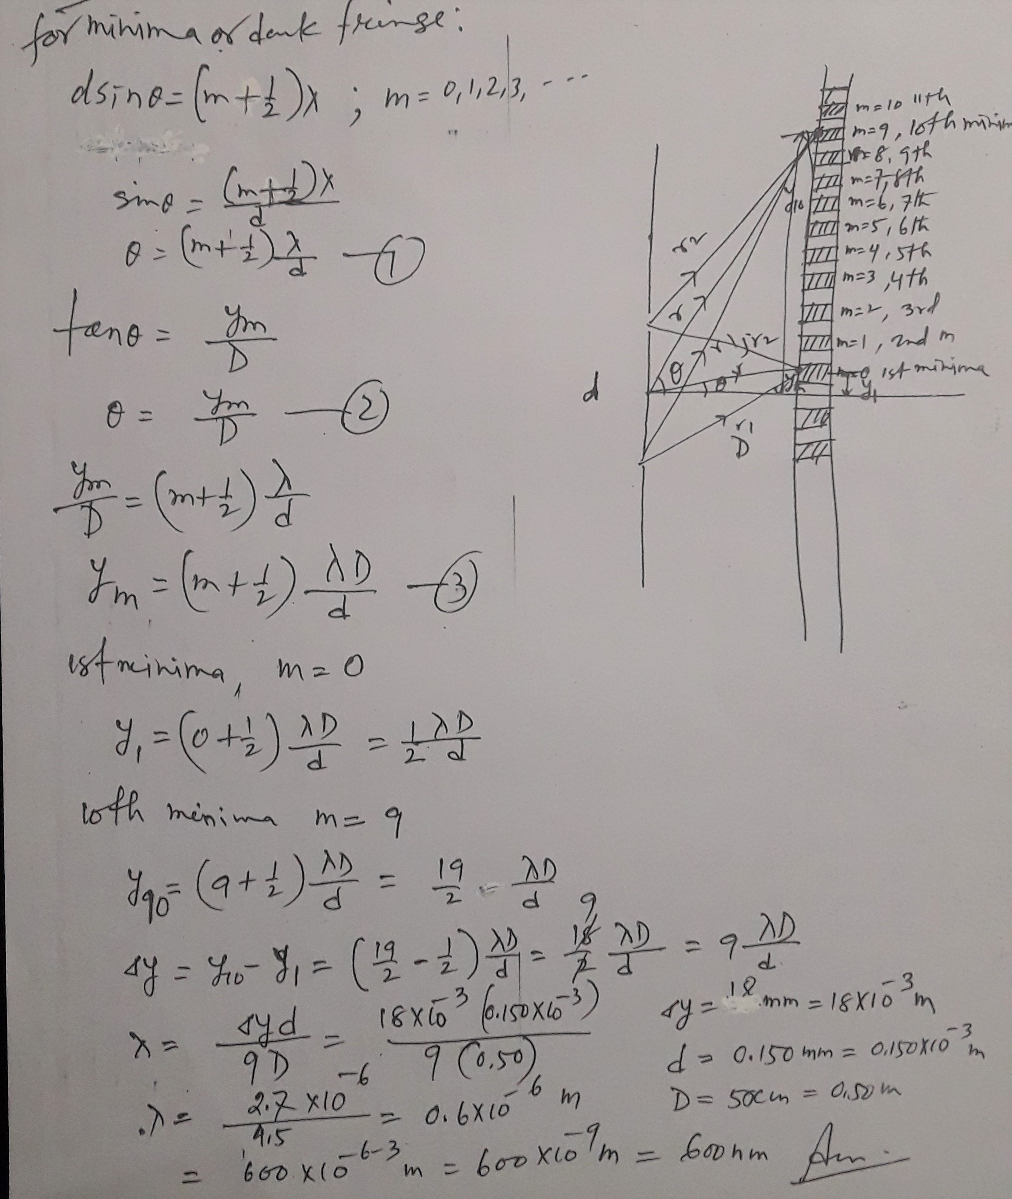

Slide 15
Additional problem: Sample problem 35.02, page: 1057

